Slide 1

1 KB Synchronous Memory Design & SystemVerilog Verification
Comprehensive RTL Implementation, Class-Based Verification Environment, Assertion Checking, and QuestaSim Analysis
Presented by: AKASH K
Electronics & Communication Engineering

Slide 2

Project Overview
Design Target: High-performance single-port synchronous random access memory (RAM).
Storage Capacity: 1 Kilobyte (1 KB) total memory structured as 256 words by 32 bits per word.
Key Specifications
Memory Architecture: Single Port Synchronous
Verification Architecture: Robust class-based SystemVerilog testbench featuring mailboxes, scoreboards, and automated checking.
Addressing: 8-bit Address Bus (256 depth)
Data Bus: 32-bit Bidirectional/Isolated Read-Write
Verification Approach: Directed + Constrained Random Stimulus
Signoff & Simulation: Validated through extensive test vectors and code/functional coverage closure in QuestaSim.

Slide 3





Project Objectives
RTL Implementation
Modular Testbench
Coverage & Assertions
Develop a fully synthesizable, clean, and bug-free Verilog memory model adhering to strict synchronous read/write protocols.
Build a scalable class-based verification infrastructure supporting automated transaction generation, BFM conversion, and scoreboarding.
Achieve complete functional and code coverage closure while enforcing protocol compliance using SystemVerilog Assertions (SVA).

Slide 4
Memory Specification Table
Parameter | Specification Value | Architectural Description
Memory Size | 1 KB | Total byte-addressable capacity equal to 1024 bytes
Data Width | 32 bits | Word-oriented data bus width for read and write operations
Depth | 256 words | Total number of individually addressable storage locations
Address Width | 8 bits | Log2(256) address lines supporting range 8'h00 to 8'hFF
Architecture | Single Port | Shared read/write access port operating under synchronous control
Read / Write | Synchronous | All memory access operations synchronized with system clock edge

Slide 5

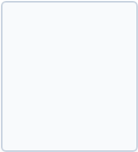




Memory RTL Architecture Block Diagram
DUT INPUTS
MEMORY DUT (memory.v)
• clk
DUT OUTPUTS
• rst
256 Words × 32-bit Array (8192 bits = 1 KB)
• valid
• rdata [31:0]
• wr_rd
• ready
• addr [7:0]
• wdata [31:0]

Slide 6
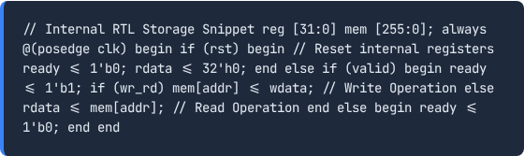
Detailed Internal Memory Organization
Memory Array Storage: Declared as an internal register array `reg [31:0] mem [255:0];`.
Synchronous Operation: Clock-edge triggered state transitions ensure hazard-free read/write execution.
Handshake Signaling: The `ready` output flag pulses or holds high to indicate successful transaction completion.

Slide 7
DUT Port Interface Summary
Port Name | Direction | Width | Description / Role
clk | Input | 1 bit | Master system clock driving all synchronous elements
rst | Input | 1 bit | Active-high or synchronous reset for initialization
valid | Input | 1 bit | Qualifies transaction request validity from master
wr_rd | Input | 1 bit | Command select: High for Write, Low for Read
addr | Input | 8 bits | Selects target word location within the 256-word array
wdata | Input | 32 bits | Input data bus latched into memory during write cycles
rdata | Output | 32 bits | Driven data bus output containing fetched word values
ready | Output | 1 bit | Handshake response confirming transaction service

Slide 8

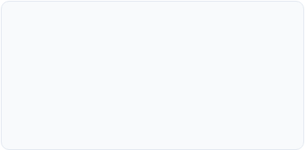
Signal Protocol & Timing Behavior
Control Signals
Address & Data Buses
Response Handshake
valid and wr_rd work in tandem. When valid is asserted, the memory inspects wr_rd on the active clock edge to determine whether to store or retrieve data.
The 8-bit address bus allows direct access across 256 unique slots. Data buses operate on full 32-bit words, eliminating byte-lane masking complexities.
The ready signal provides deterministic feedback, allowing testbench verification components and external masters to track cycle accuracy.

Slide 9

Memory Addressing & Word Organization
Address Range: Spans from `8'h00` (Lower boundary) to `8'hFF` (Upper boundary).
Word Granularity: Each address index maps to an indivisible 32-bit register word.
⋮
Capacity Calculation: 256 words × 32 bits = 8192 bits = 1024 bytes = 1 KB.

Slide 10





Write Operation Flow
During a write cycle, data present on the wdata bus is safely written into the targeted memory array index on the positive clock edge.

Slide 11





Read Operation Flow
Synchronous read operations fetch the stored word at the requested address and present it on the rdata bus alongside an active ready handshake.

Slide 12

Reset Operation Behavior
Asynchronous/Synchronous Reset: Driven via the active signal `rst`.
Reset Impact
Output Clearing: Forces output data bus `rdata` to `32'h0` and resets the `ready` handshake flag to `1'b0`.
While control registers and output staging are cleared during reset, the underlying RAM cell storage array contents remain intact unless explicitly overwritten by write operations.
Deterministic State: Guarantees clean initialization prior to test stimulus application.

Slide 13
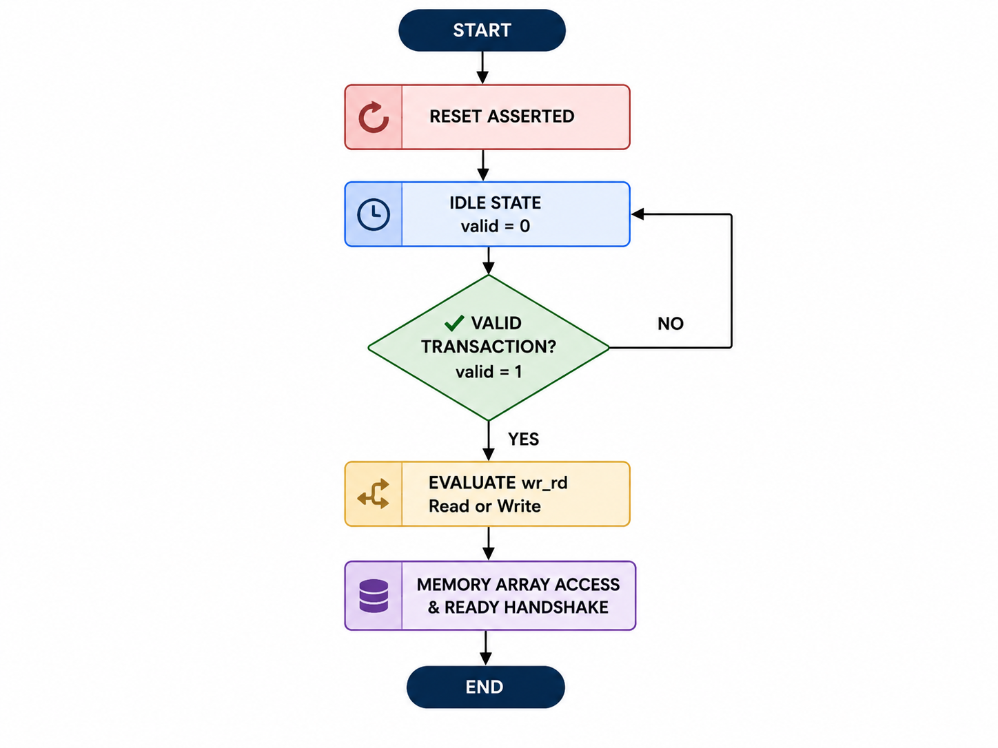
Memory State & Working Flow

Slide 14
SystemVerilog Verification Architecture
Transitioning from RTL design to advanced class-based verification methodology.

Slide 15
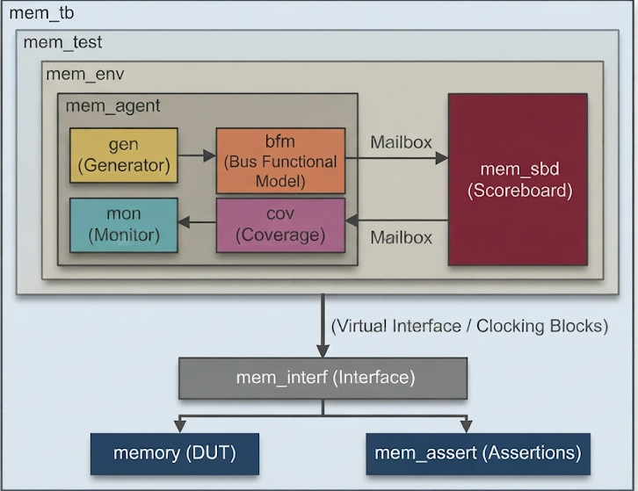
SystemVerilog Testbench Hierarchy (`mem_tb`)

Slide 16

Test Controller: `mem_test`
Test Orchestration: Instantiates the top-level verification environment (`mem_env`).
Purpose & Function
Configuration Management: Sets test parameters, simulation durations, and stimulus seed constraints.
mem_test acts as the brain of the verification suite, ensuring that individual test scenarios execute cleanly and report pass/fail status to the simulation log.
Execution Control: Triggers test sequences (e.g., address sweep, boundary tests) and monitors completion.

Slide 17
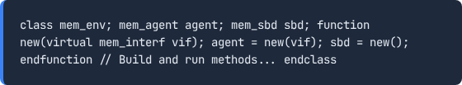
Environment Container: `mem_env`
Component Integration: Encapsulates the verification agent (`mem_agent`) and scoreboard (`mem_sbd`).
Inter-Component Wiring: Connects monitor broadcast channels to the scoreboard and coverage collector.
Modular Design: Ensures clean separation of stimulus generation, driving, monitoring, and checking.

Slide 18






Verification Agent: `mem_agent`
The agent packages all interface-level verification components into a cohesive, reusable unit connected directly to the virtual interface.

Slide 19
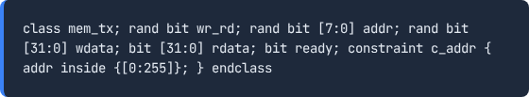
Transaction Object: `mem_tx`
Data Packet Structure: Represents a single bus operation with randomized or directed fields.
Randomization Support: Includes constraint blocks for valid address distributions and data patterns.

Slide 20

Stimulus Generator: `mem_gen`
Transaction Creation: Instantiates and randomizes `mem_tx` transaction objects.
Mailbox Synchronization
Mailbox Communication: Passes generated stimulus packets safely to the BFM via SystemVerilog mailboxes.
The generator uses blocking mailbox::put() calls to synchronize stimulus flow, preventing driver starvation or buffer overflows.

Slide 21
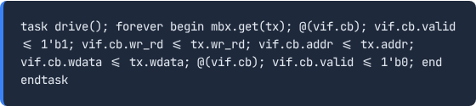
Bus Functional Model (BFM / Driver): `mem_bfm`
Protocol Translation: Converts abstract transaction objects into cycle-accurate pin-level wiggles.
Clocking Block Compliance: Drives signals respecting setup and hold times across the virtual interface.

Slide 22
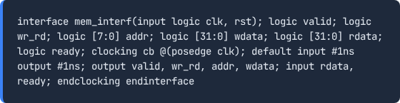
Interface & Clocking Blocks: `mem_interf`
Signal Bundling: Groups physical DUT wires into a clean interface construct.
Race Prevention: Utilizes clocking blocks with skew definitions to eliminate testbench-DUT race conditions.

Slide 23
DUT Monitor: `mem_mon`
Bus Snooping: Continuously samples physical interface signals during active transaction windows.
Observation Role
Transaction Reconstruction: Reconstructs bus activity into transaction objects and broadcasts them to the scoreboard and coverage collector.
The monitor is purely passive; it does not drive signals, ensuring that verification observations remain completely non-intrusive to DUT execution.

Slide 24





Scoreboard Architecture: `mem_sbd`

Slide 25
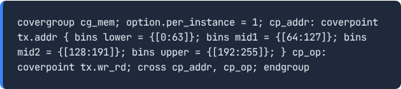
Functional Coverage: `mem_cov`
Coverage Model: Samples address bins, write/read operations, and data patterns.
Cross Coverage: Evaluates correlations between operation type (`wr_rd`) and target address ranges.

Slide 26



SystemVerilog Assertions (`mem_assert`)

Slide 27






Complete Verification Transaction Flow

Slide 28
Executed Test Scenarios
Test Name | Purpose | Stimulus Description | Expected Behavior
addr_sweep | Full memory depth validation | Sequential writes and reads across addresses 00h to FFh | Zero scoreboarding mismatches across all 256 words
boundary | Upper/lower limit checking | Targeted access to index 00h and FFh | Accurate data retention at extreme boundaries
unwritten | Uninitialized read behavior | Reading unwritten memory slots | Predictable default or zero read outputs
nwr_nrd | Idle / disabled validation | Transactions with valid = 0 | DUT state remains static with no unintended writes

Slide 29
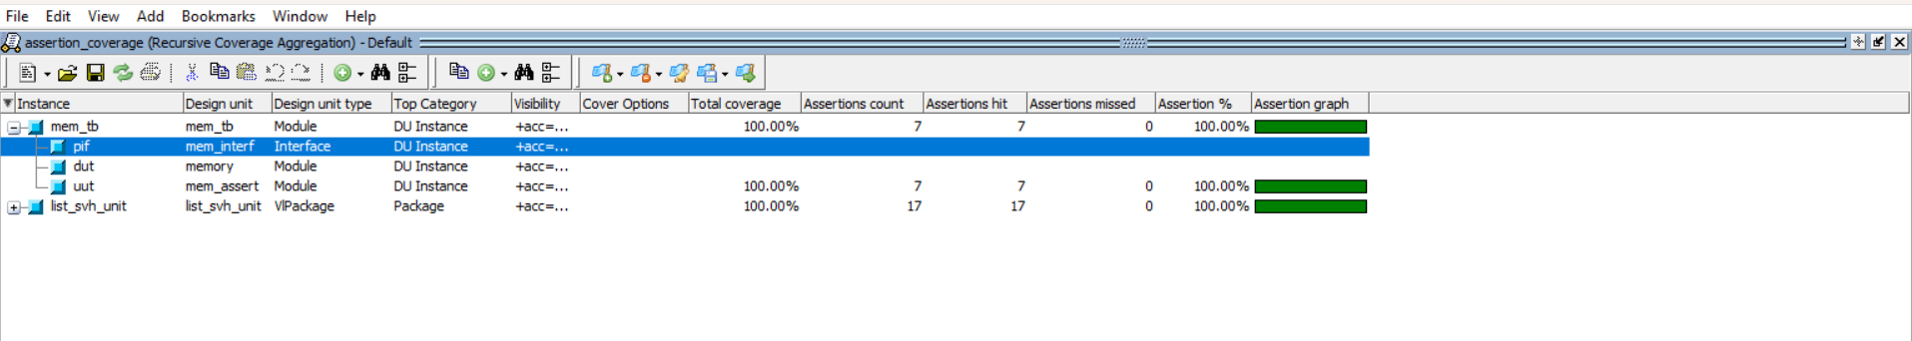
Coverage Results Summary
Functional Coverage: 100% bin coverage achieved across all address segments, read/write opcodes, and cross combinations.
Statement Coverage: 100% execution path validation across all procedural RTL blocks.
Toggle & Branch: 100% toggle and branch coverage verified in QuestaSim database logs.

Slide 30
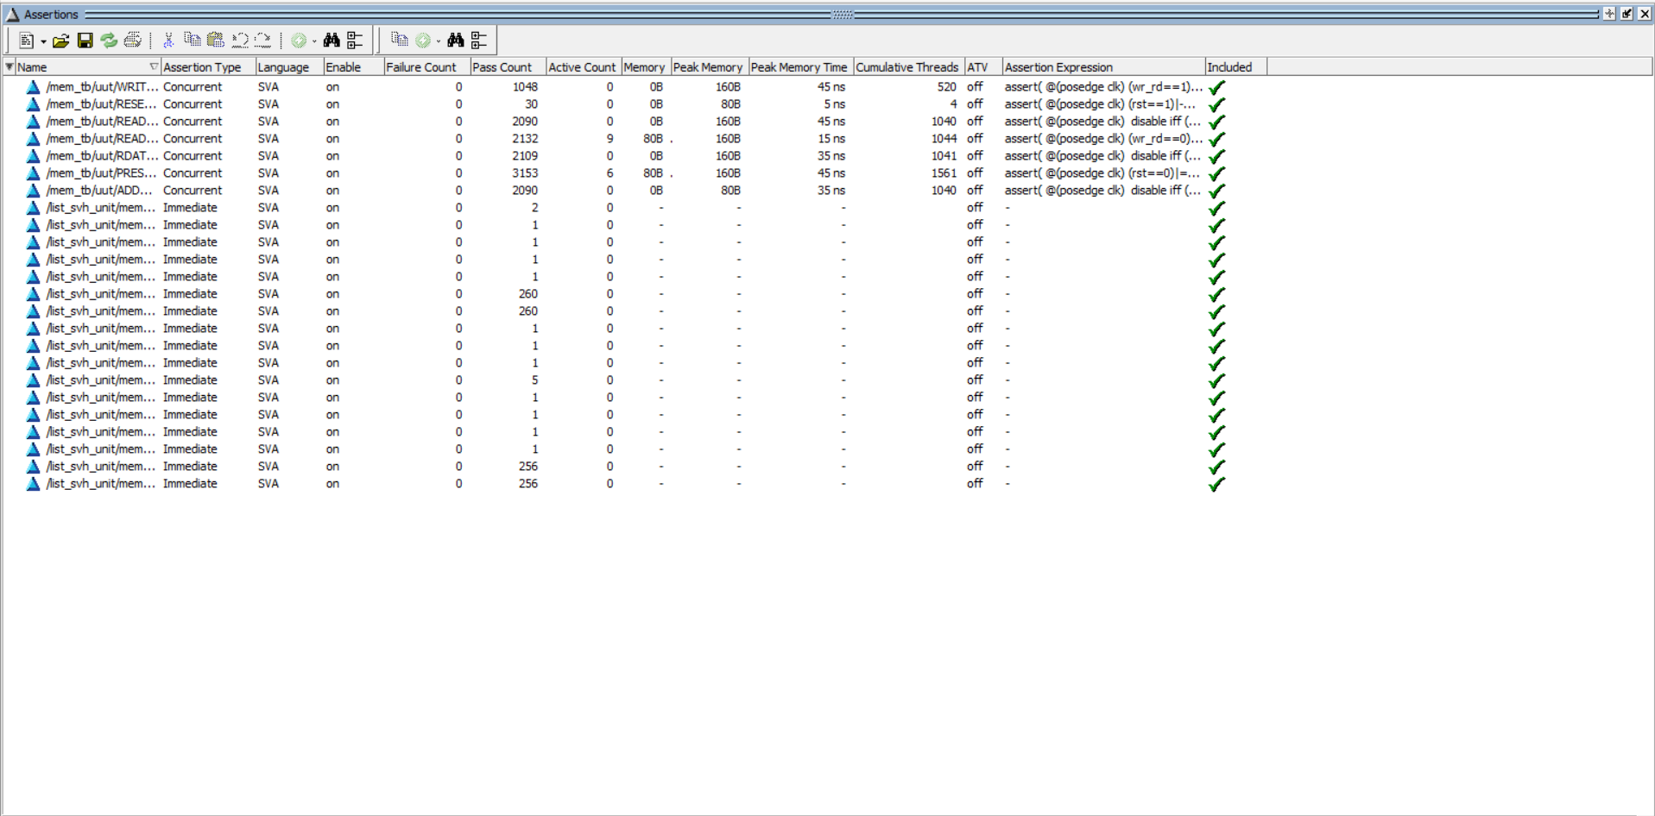
QuestaSim Assertion Analysis
Zero Failures: All SVA assertion properties passed cleanly without protocol violations.
Timing Verification: Confirmed correct clock alignment, valid qualification, and ready handshake response across write/read transactions.

Slide 31
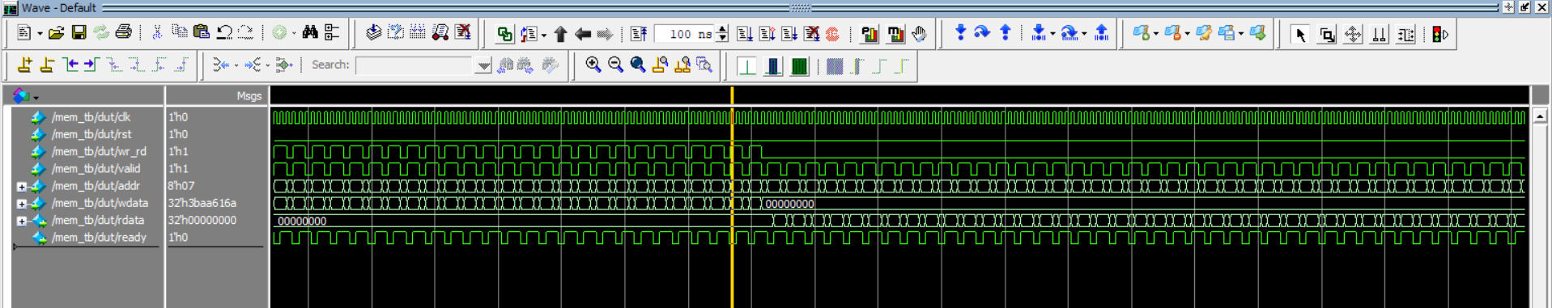
QuestaSim Output Waveform
Read/Write Verification: Successfully verified memory read and write operations.
Signal Timing: Confirmed correct clk, valid, wr_rd, addr, and ready behavior.
Data Integrity: Verified correct wdata and rdata during transactions.

Slide 32






Verification Flow Summary

Slide 33

Project Results Summary
RTL Design
Testbench
Assertions
Simulation
1 KB Synchronous Memory (256 × 32) successfully synthesized and verified.
Modular class-based architecture with scoreboard and functional coverage.
SystemVerilog Assertions validating protocol integrity with zero errors.
Fully verified in QuestaSim with complete regression database signoff.

Slide 34
Conclusion & Future Scope
Conclusion
Future Scope
The 1 KB synchronous memory project was successfully implemented and verified using an advanced class-based SystemVerilog testbench. Complete functional closure and robust assertion coverage were achieved.
Migration to Universal Verification Methodology (UVM).
Extension to multi-port memory architectures.
Advanced constrained-random error injection scenarios.

